Slide 1
Statistical Methodology for
Software Engineering
Hadas Lapid, PhD
Statistics for Software
Engineers
Notes:
An Introduction to Statistical Methods and Data Analysis 7th Edition
R. Lyman Ott Michael Longnecker
Chap. 4.12, page 212

Slide 2
Contents
• Central Limit Theorem
• Hypothesis Testing
Statistics for Software
Engineers

Slide 3
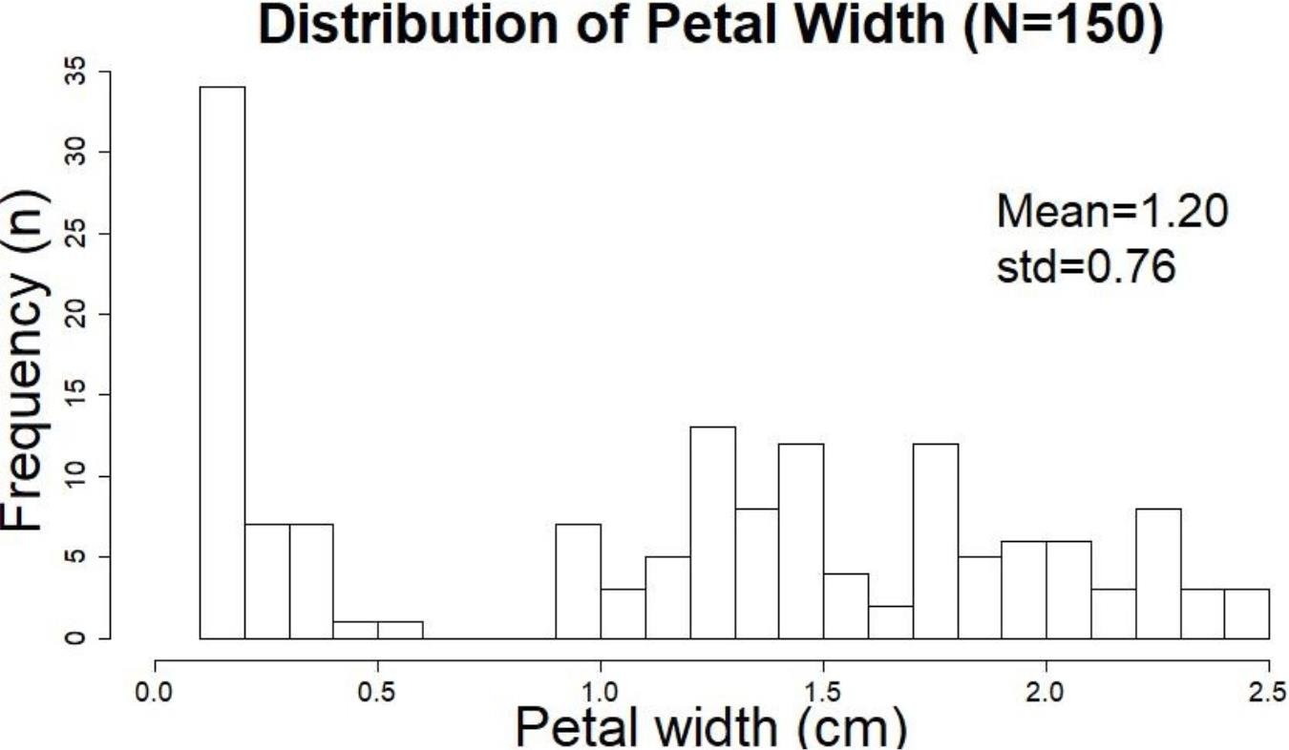
Central limit theorem -
Statistics for Software
Engineers

Slide 4
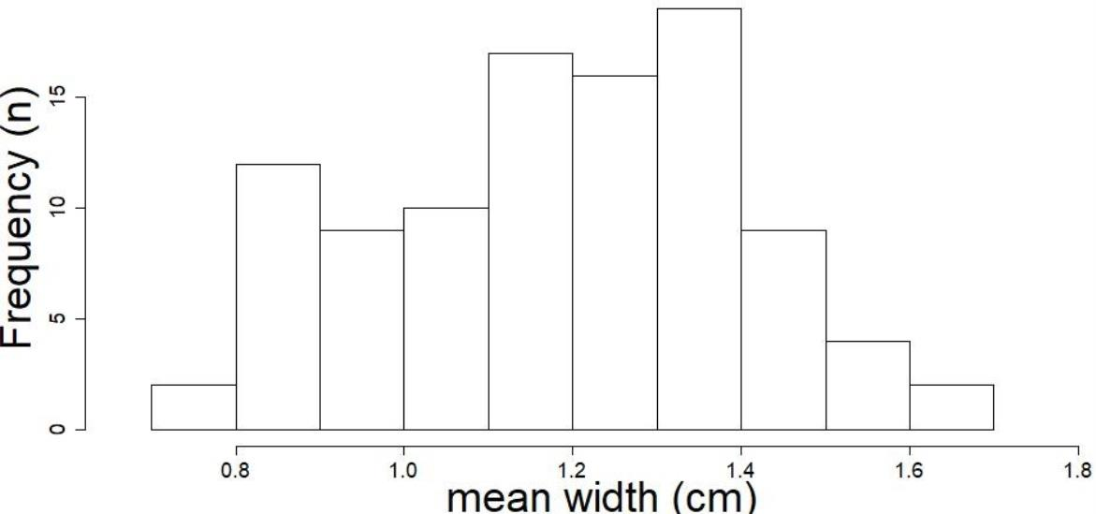
Central limit theorem -
Distribution of the means of 100 random
samples of n=10 petal widths
Statistics for Software
Engineers

Slide 5
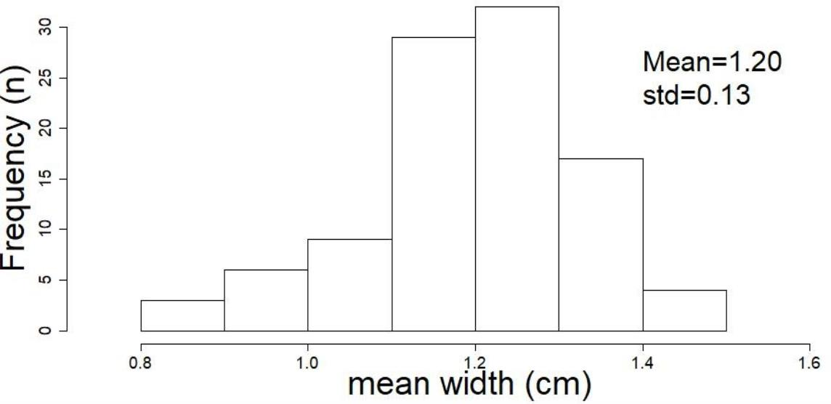
Central limit theorem -
Distribution of the means of 100 random
samples of n=30 petal widths
Statistics for Software
Engineers

Slide 6
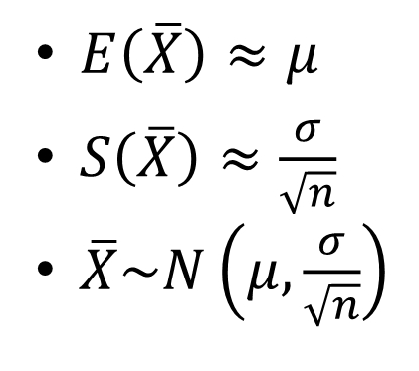
Central limit theorem–informal definition
• The probability distribution of the mean of
repeated, independent, large enough, random
samples of a variable will always be normal,
even if the variable itself does not distribute
normally.
• Large enough ≈ 30
Statistics for Software
Engineers
Notes:
S - Mean Error
Sigma - Population standard Deviation
N - Sample size
S = Sigma / sqrt(N)
Population and sample standard deviation
https://www.khanacademy.org/math/statistics-probability/summarizing-quantitative-data/variance-standard-deviation-sample/a/population-and-sample-standard-deviation-review
---------------------
Introductory Stattistics
Prem S. Mann
7.2 P. 281
Population mean – Mue
Sample X mean – MueX not equal Mue
-------------------
σ^2 = ∑ (x - μ)^2 / N s^2 = ∑ (x – E(x))^2 / (n – 1)
σ = SQRT( ∑ (x - μ)^2 / N ) s = SQRT( ∑ (x – E(x))^2 / (n – 1) )
σ^2 - the population variance
s^2 - the sample variance
σ - the population standard deviation
s - the sample standard deviation.
x - μ or x – E(x) - Sampling Error Sampling error is the difference between the value of a sample statistic and the value of the corresponding population parameter

Slide 7
Hypothesis Testing
Basic terminology
Unknown population parameter (e.g., μ)
Null hypothesis: H₀
Alternative Hypothesis: H₁
One-sided / two-sided alternative
Test statistic
Statistical test
Rejection region, R
Probability of Type I error, σ
Probability of Type II error, β
Power
p value
Statistics for Software
Engineers
Notes:
פעמים רבות אנחנו צריכים לקבל החלטות לגבי האוכלוסייה מתוך מדגם קטן שיש לנו.
כדי לקבל החלטות סטטיסטיות, נוח להניח הנחות לגבי האוכלוסייה, שיכולות להיות נכונות או לא...
הנחות אלו קרויות הנחות סטטיסטיות – Statistical Hypothesis
והן משקפות קביעות לגבי פילוג ההסתברות שלהן.
הנחת הבסיס היא שאין שוני בין 2 מדגמים שנמדדים מתוך אוכלוסייה
הנחה זו תופשת גם במקרה של טיפול מסוים
הנחת הבסיס מכונה "הנחת האפס" ומסומת 0H
הנחת האפס דומה למקובל במשפט שם הנאשם חף מפשע עד שהוכחה אשמתו
כל הנחה שונה מהנחת האפס מסומנת כ 1H
In the significance testing approach of Ronald Fisher, a null hypothesis is rejected if the observed data is significantly unlikely to have occurred if the null hypothesis were true. In this case, the null hypothesis is rejected and an alternative hypothesis is accepted in its place. If the data is consistent with the null hypothesis, then the null hypothesis is not rejected. In neither case is the null hypothesis or its alternative proven; the null hypothesis is tested with data and a decision is made based on how likely or unlikely the data is. This is analogous to the legal principle of presumption of innocence, in which a suspect or defendant is assumed to be innocent (null is not rejected) until proven guilty (null is rejected) beyond a reasonable doubt (to a statistically significant degree).^{[4]}
In the hypothesis testing approach of Jerzy Neyman and Egon Pearson, a null hypothesis is contrasted with an alternative hypothesis, and the two hypotheses are distinguished on the basis of data, with certain error rates. It is used in formulating answers in research.
In inferential statistics, the null hypothesis (often denoted H₀,^{[1]}) is a general statement or default position that there is no difference between two measured phenomena or that two samples derive from the same general population
Methods for making inferences about parameters fall into one of two categories.
Either we will estimate the value of the population parameter of interest
“What is the value of the population parameter?”
Or we will test a hypothesis about the value of the parameter.
“Does the population parameter satisfy a specified condition
for example, ‘mean > 20’ or ‘pi < .3’ ?”

Slide 8
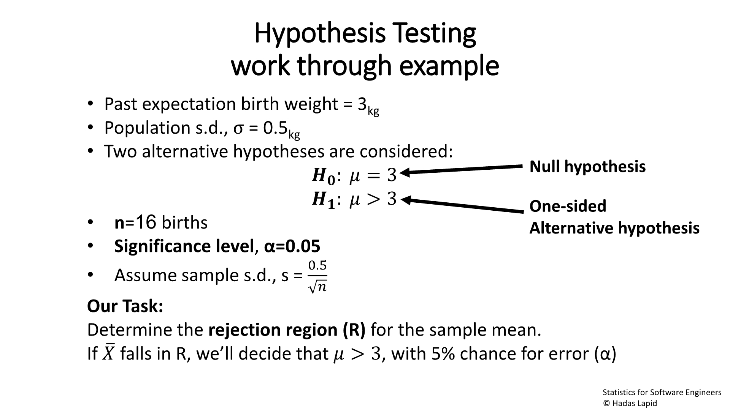



Hypothesis Testing
work through example
• Past expectation birth weight = 3_{kg}
• Population s.d., σ = 0.5
kg
• Two alternative hypotheses are considered:
ꢀ
Null
: ꢀ = 3
ꢀ
ꢀ
ꢀ
: ꢀ > 3
hypothesis
• n=16 births
• Significance level, α=0.05
One-sided
Alternative
hypothesis
• Assume sample s.d., s =
0.5
ꢀ
Our Task:
Determine the rejection region (R) for the sample mean.
ത
falls in R, we’ll decide that ത > 3, with 5% chance for error (α)
If
ത
Statistics for Software
Engineers
Notes:
Inference – הסקה
הצגת התוצאות וניתוחם יכול לתת לנו תובנות על המדגם שלנו אבל בחיים אנחנו רוצים להסיק מזה על כלל האוכלוסייה ממנה נלקח המדגם.
https://en.wikipedia.org/wiki/Statistical_hypothesis_testing
A statistical hypothesis is a hypothesis that is testable on the basis of observed data modeled as the realised values taken by a collection of random variables.^{[1]}
A set of data (or several sets of data, taken together) are modelled as being realised values of a collection of random variables (for example mean of each set) having a joint probability distribution in some set of possible joint distributions. The hypothesis being tested is exactly that set of possible probability distributions.
A statistical hypothesis test is a method of statistical inference. An alternative hypothesis is proposed for the probability distribution of the data, either explicitly or only informally. The comparison of the two models is deemed statistically significant if, according to a threshold probability -- the significance level -- the data is very unlikely to have occurred under the null hypothesis. A hypothesis test specifies which outcomes of a study may lead to a rejection of the null hypothesis at a pre-specified level of significance, while using a pre-chosen measure of deviation from that hypothesis (the test statistic, or goodness-of-fit measure). The pre-chosen level of significance is the maximal allowed "false positive rate". One wants to control the risk of incorrectly rejecting a true null hypothesis.
The process of distinguishing between the null hypothesis and the alternative hypothesis is aided by considering two conceptual types of errors. The first type of error occurs when the null hypothesis is wrongly rejected. The second type of error occurs when the null hypothesis is wrongly not rejected. (The two types are known as type 1 and type 2 errors.)
5.2 estimation of mue (page 235)
sample mean y as a point estimate of mue;
interval estimate for the population mean mue. From the Central Limit Theorem for the sample mean (Chapter 4), we know that for a large n, y will be approximately normally distributed, with a mean mue and a standard error s/squr(n). Y ~ N(mue, s/sqr(n))
Then from our knowledge of the Empirical Rule and areas under a normal curve, we know that the interval mue +- 2s/sqr(n), or, more precisely, the interval mue +- 1.96s/sqr(n), includes 95% of the ys in repeated sampling, as shown in Figure 5.1. From Figure 5.1, we can observe that the sample mean y may not be very close to the population mean m, the quantity it is supposed to estimate. Thus, when the value of y is reported, we should also provide an indication of how accurately y estimates m.
The probability of y falling in the interval mue +- 1.96s/sqr(n) is .95
So we state that mue +- 1.96s/sqr(n) is an interval estimate of mue with level of confidence .95.
We evaluate the goodness of an interval estimation procedure by examining the fraction of times in repeated sampling that interval estimates would encompass the parameter to be estimated. This fraction, called the confidence coefficient, is .95 when using the y +- 1.96s/sqr(n) ; that is, 95% of the time in repeated sampling the intervals calculated using the formula y +- 1.96s/sqr(n) will contain the mean mue.

Slide 9
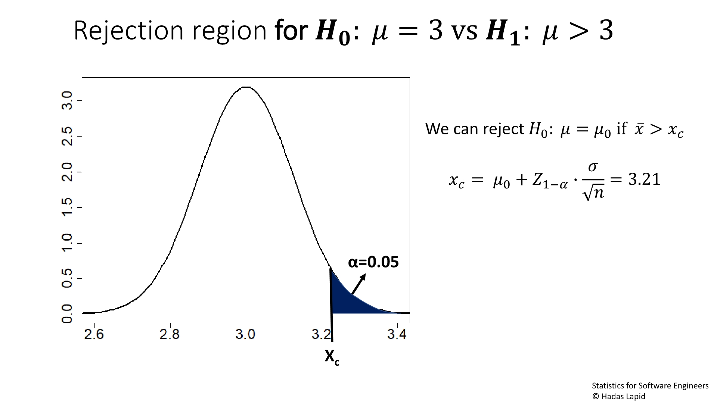
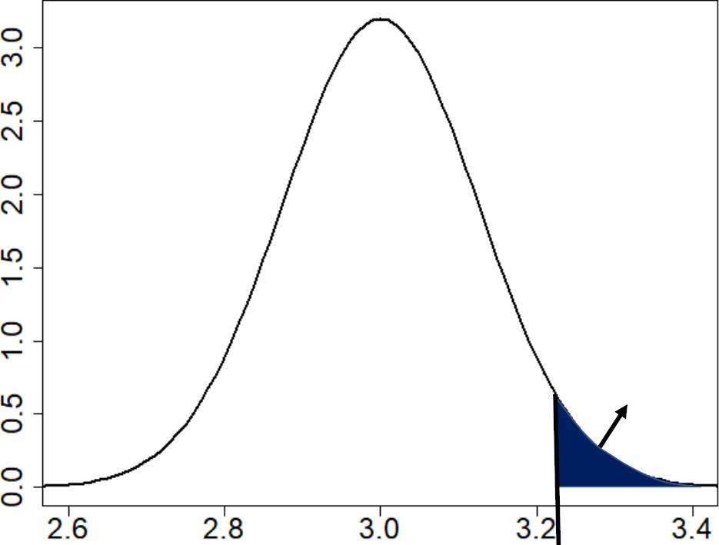

ꢀ
ꢀ = 3 vs
Rejection region for
ꢀ
:
ꢀ
: ꢀ > 3
ꢀ
ꢀ
: ꢀ = ꢀ if
We can reject
0
0
ꢀ >
ꢀ ꢀ
ꢀ
ത =
ത +
ത
ത
ꢀ
0
1−ത
∙
= 3.21
α=0.0
Statistics for Software
Engineers
Notes:
S – Population std
Sigma - Sample STD
N – Sample size
S = Sigma / sqrt(n)
Small Sample Estimation of a Population Mean
https://stats.libretexts.org/Bookshelves/Introductory_Statistics/Book%3A_Introductory_Statistics_(Shafer_and_Zhang)/07%3A_Estimation/7.02%3A_Small_Sample_Estimation_of_a_Population_Mean
Xc = 3+1.645*0.5/sqrt(16) = 3.21

Slide 10
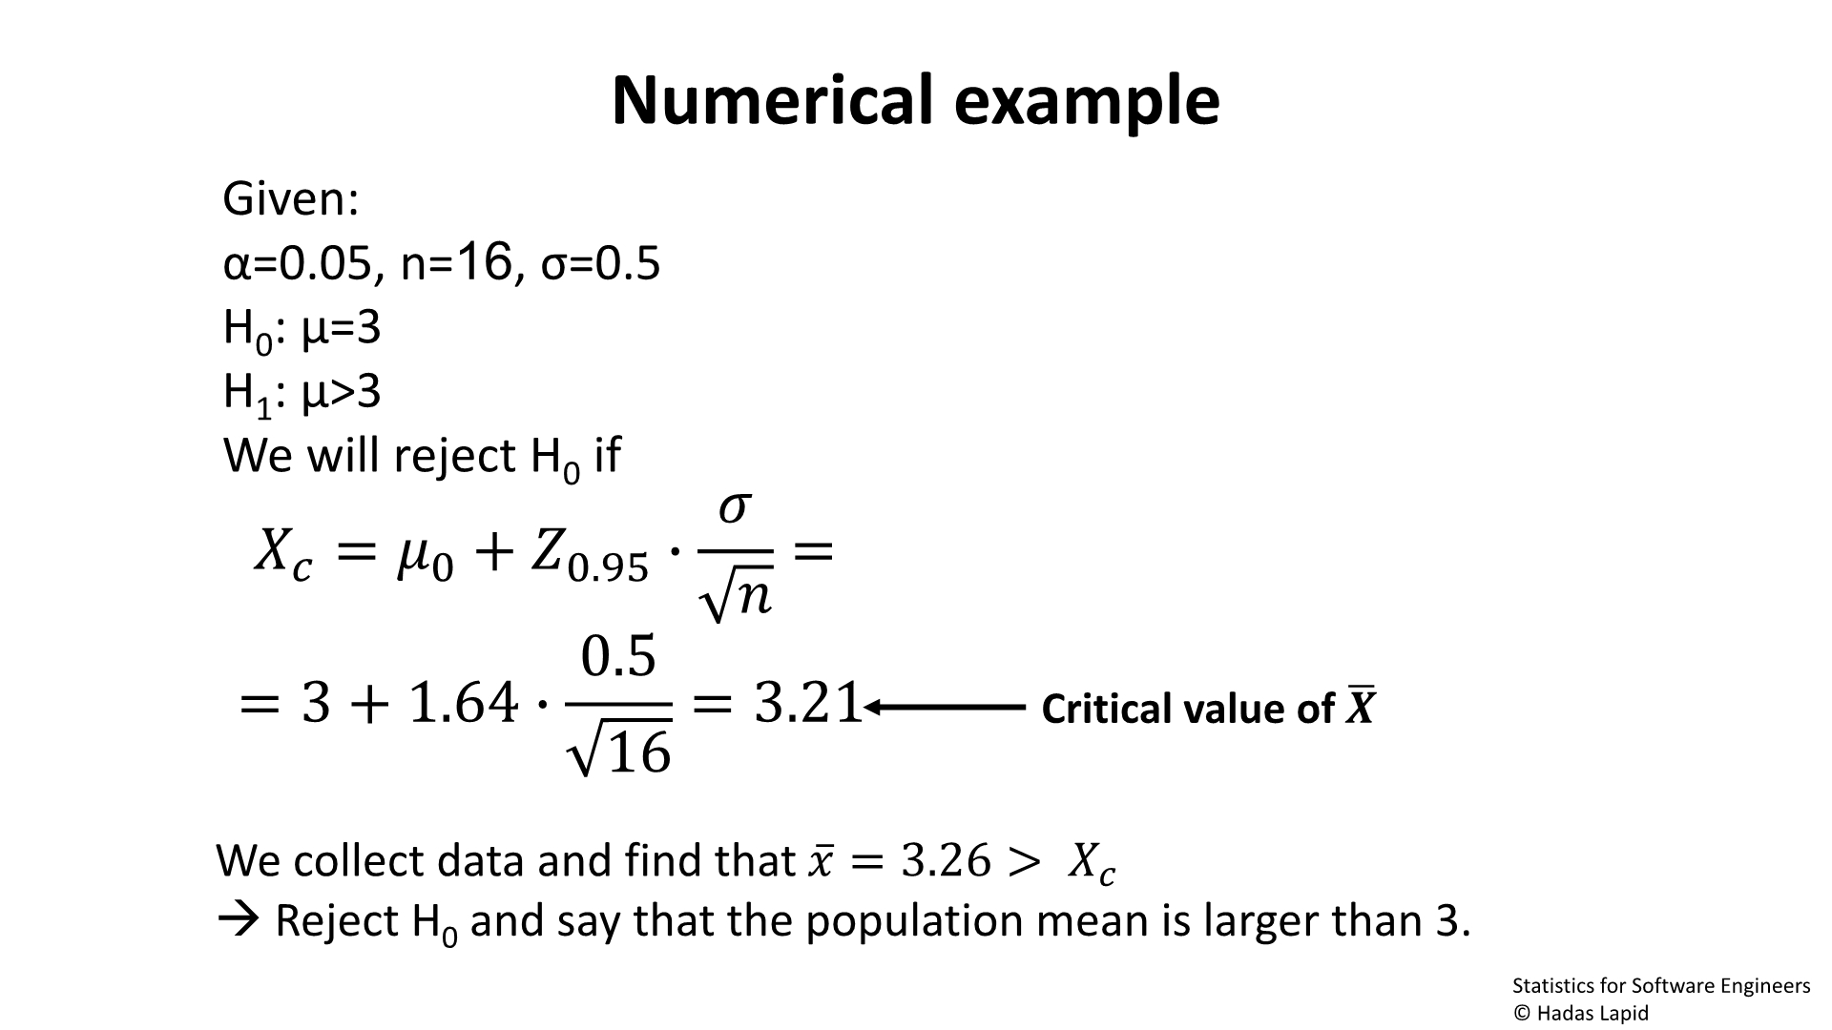


Numerical example
Given
:
α=0.05, n=16, σ=0.5
H₀: μ=3
H : μ>3
1
We will reject H if
ꢀ
0
ത
= ത +
0
ത
ꢀ
ത
∙
=
0.95
0.5
ത
Critical value
= 3 + 1.64 ∙ = 3.21
ത
16
of
Statistics for Software
Engineers
Notes:
1-Alpha = Probability that Mue falls in Interval around E(X)
Level of Significance 0.10 0.05 0.01 0.005 0.002
Critical Values of z for 1.28 -1.645 –2.33 -2.58 -2.88
One-Tailed Tests or 1.28 or 1.645 or 2.33 or 2.58 or 2.88
Critical Values of z for -1.645 -1.96 –2.58 -2.81 -3.08 Two-Tailed Tests and 1.645 and 1.96 and 2.58 and 2.81 and 3.08
Confidence Value of Area in Corresponding
Coefficient Table 1 z-Value
a (1-a) a/2 1-a/2 za/2
0.1 0.9 0.05 0.95 1.645
0.05 0.95 0.025 0.975 1.96
0.02 0.98 0.01 0.99 2.33
0.01 0.99 0.005 0.995 2.58

Slide 11
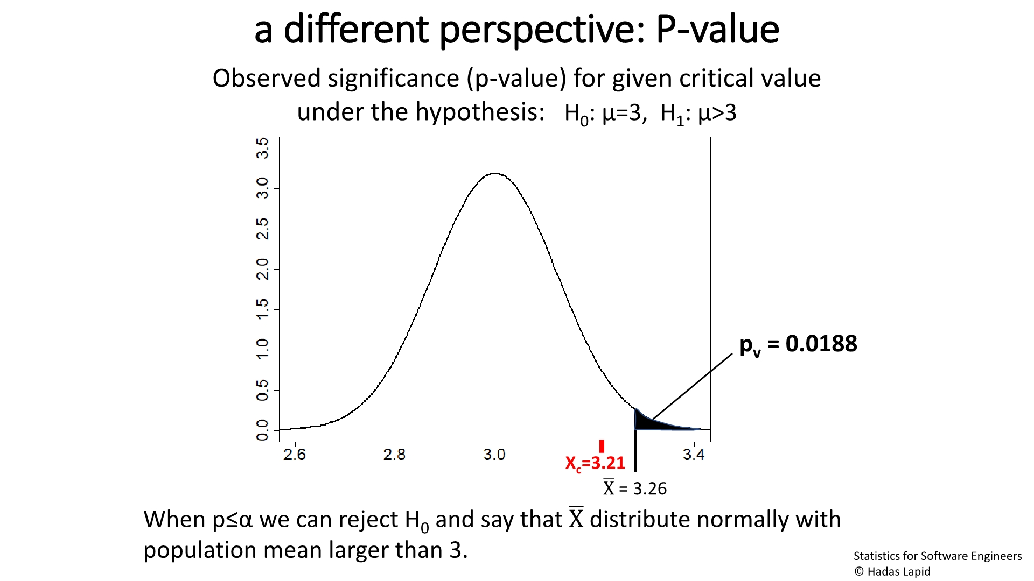
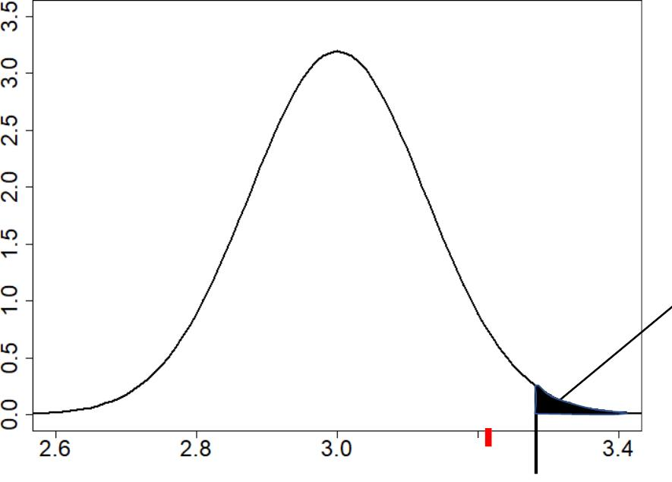
a different perspective: P-value
Observed significance (p-value) for given critical
value under the hypothesis: H : μ=3, H : μ>3
0
1
p_{v} = 0.0188
X =3.2
c
ത= 3.26
X
When p≤α we can reject H₀ and say ത
X distribute normally with
that
population mean larger than
Statistics for Software
Engineers
Notes:
Ave(X) > Xc
P(X) < alpha
P<alpha → Mue is in the rejection zone (ave(X) higher then Xc)
Z = (X - m)/(s/√n) = (3.26-3)/(0.5/√16) = 0.26*8 = 2.08
P(z) = P(2.08) = 0.0188 < 0.05 → reject H₀

Slide 12
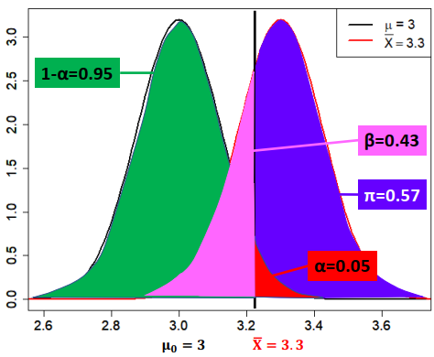

Probability of Error and the Inference Power
Positive = decide H₁ Negative = decide H₀
α = false positive (type I) - P(H1|H0)
1-α = true negative (power) - P(H0|H0) β = false negative (type II) - P(H0|H1) π = 1 – β = true positive - P(H1|H1)
Statistics for Software
Engineers
Notes:
H0 – Negative - בריא
H1 - Positive - חולה
H0 – null hypothesis of all pups (mean and sigma of H0 is known)
H1 – alternative (research) hypothesis in case of Labrador pups
P(H1|H0) = α
α = type I error - False Positive - P(H1|H0) - The hypothesis H0 is true but is rejected β = type II error - False Negative - P(H0|H1) - The hypothesis H0 is not rejected although it is wrong power of the test = P(H1|H1)
Type 1 – להסיק חולה כאשר האדם בריא
Type 2 – להסיק בריא כאשר האדם חולה
m = 3 - Null Hypothesis
m₀ = 3.3 - Actual value of the mean in Alternative Hypothesis H1
Z_{0.05} = 1.64
Test Statistics
Z = (m₀ – m)/(σ/√n) = (3.3-3)/(0.5/√16) = 0.3/1/8 = 2.4
Calculation of β(3.3) (in alternative hypothesis)
P(z < Z_{0.05} – Z) = P(z < 1.64-2.4) = P(z < -0.76) = 0.2236
β(395) = 0.2236
power PWR(m₀) = 1- β(395) = 0.7764

Slide 13
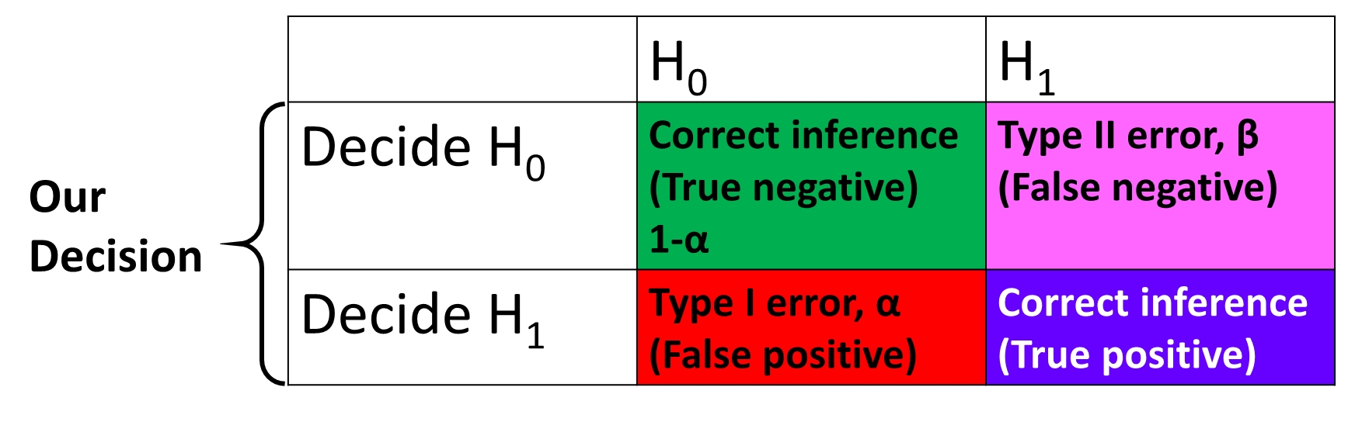
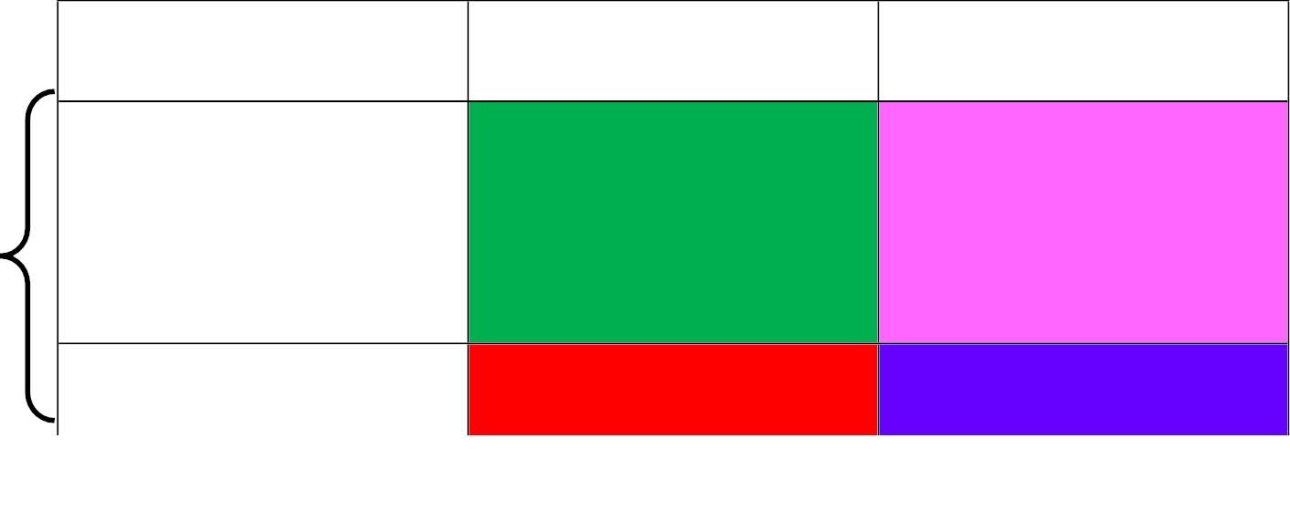
Probability of Error and Inference Power
The actual truth
H₀
H₁
Decide H
Correct inference (True negative)
1-α
Type II error, β
(False negative)
Our
Decision
0
Decide H₁ Type I error, α Correct
inference (True
Statistics for Software
Engineers

